Slide 1
CipherChat
A Secure, Decentralized Chat Application
Group: K.O.D Inc
Members: Ottor Mills
Kenneth Anglin
Nicoy Smith
David Thomas

Slide 2
Motivation
In today’s world the internet has become a hotbed of hacking plots at data harvesting. CipherChat was created based on the premise that everyone should be entitled to their privacy regardless of how ignorant that individual may be.

Slide 3
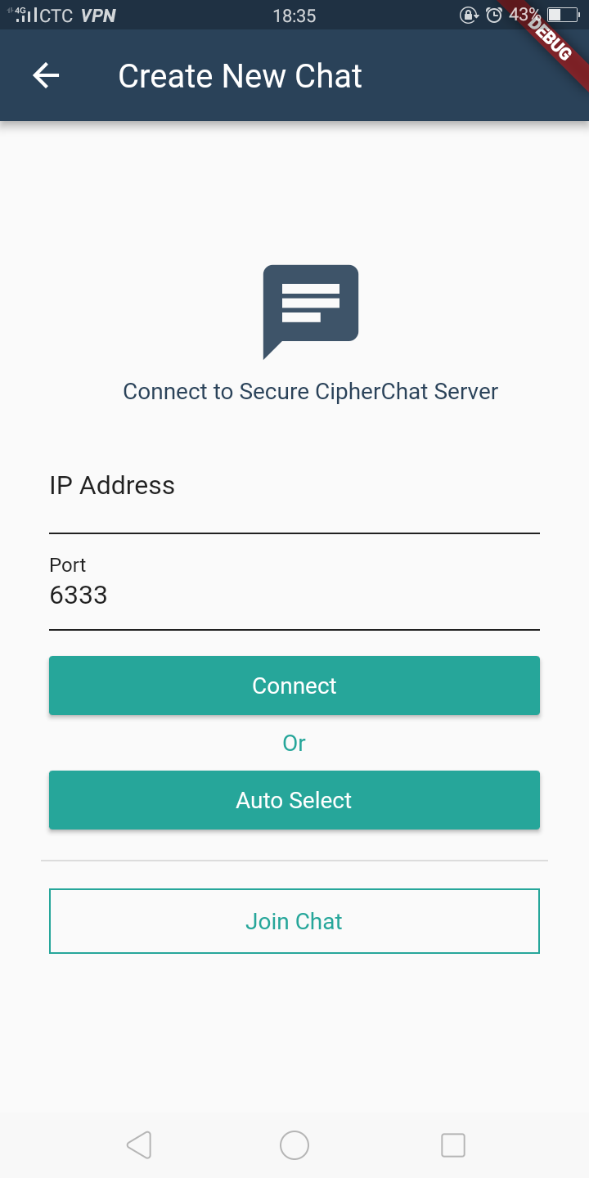
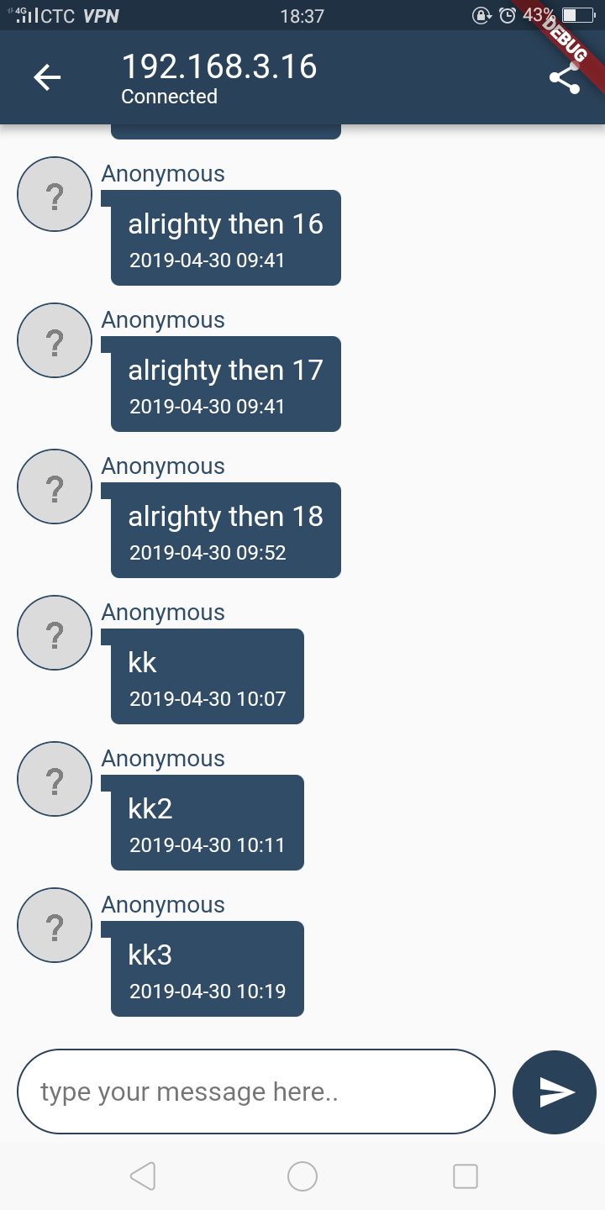
User Interface

Slide 4
Tools Used
The following languages contributed to completion of this project
TypeScript (Server)
JavaScript (Server & Client)
Dart (Client)
SQL (Server & Client)
Bash Scripting Language (Server)

Slide 5
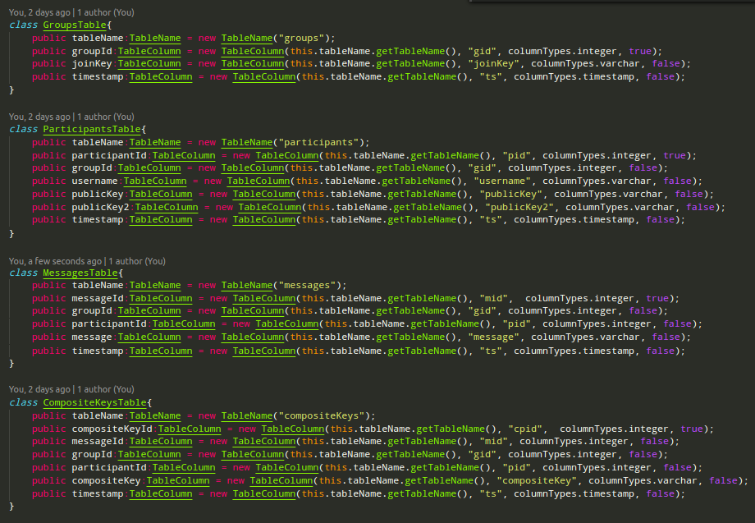
Database Schema
MYSQL Database schema (TypeScript)

Slide 6
Cryptography
CipherChat is Made Secure through the implementation of the following cryptographic technologies:
Hypertext Transfer Protocol Secure
Elliptic Curve Diffie Hellman Key Exchange Protocol
Elliptic Curve Digital Signature Algorithm
Advanced Encryption Standard (256 bit)

Slide 7
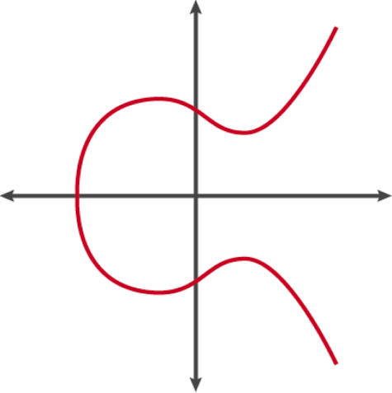
Chosen Elliptic Curve
SECP256k1
Used by government agencies and many cryptocurrencies due to special properties

Slide 8
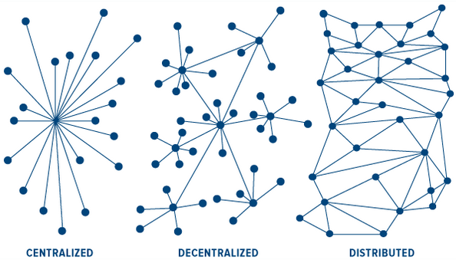
Why Decentralization?
Decentralization creates a network which naturally more stable and accessible. Using digital signatures, the authenticity of messages can be verified

Slide 9
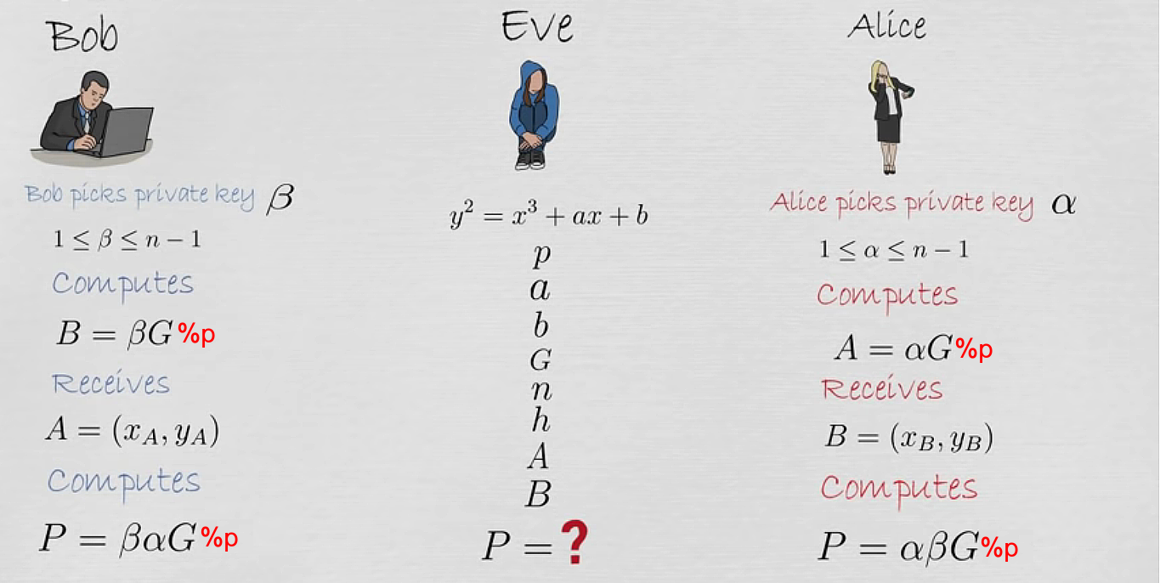
Elliptic Curve Diffie Hellman

Slide 10
Method
Multiple clients connect to a CipherChat server
Clients exchange public keys using ECDH
Messages are encrypted using the generated symmetric key and AES
Messages are signed using ECDSA Signing
The encrypted message is sent to the server
The server verifies the authenticity of the message using the signature (ECDSA Verification)
Server saves the authenticated message
The other peer(s) sends requests to the server and receive the latest messages
The received messages are decrypted using the symmetric key and AES

Slide 11
Diffie Hellman Vulnurability
Although Diffie Hellman can defend against passive attackers it is vulnerable to Man in the Middle Attack. In this case the server may function as two or more separate peers, decrypting and re-encrypting messages before sending them to the intended recipient.
Current Solution
Host and use your own server
This vulnerability will addressed later in this presentation

Slide 12

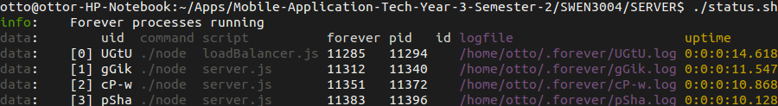
Load Balanced Servers
CipherChat Servers are designed to be scalable. Multiple instances can be ran simultaneously on separate threads with each instance handling tasks asynchronously, maximizing efficiency

Slide 13
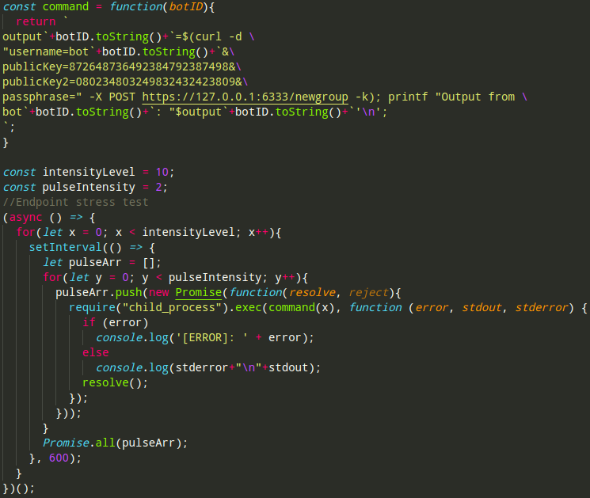
Stress Tester

Slide 14
Open Source
Food for Thought
Why should anyone trust applications if they cannot prove for themselves that it is secure?
Applications should be secure by design and not by policy!
CipherChat is Open Source. By design, CipherChat is dependable if a known server is used for each conversation (else MITM vulnerability) and will evolve to be trustless regardless of which server is used.
https://github.com/CipherChat/CipherChat/

Slide 15
Similar Software
Extensible Messaging and Presence Protocol (XMPP)
Uses XML instead of JSON
Developed in 1999
Used today (eg. Whatsapp)

Slide 16
Demonstration

Slide 17
Future Improvements
Use of websockets instead of polling
Restrict Public Key Exchange to face-to-face interaction only
Create more incentives for person to host their own CipherChat servers
Notifications
Make app multilingual
Allow for the parsing of more complex data such as images and videos
Implement a broadcast method to transfer messages to other CipherChat nodes
Research into DDOS protection mechanisms
Migration from JavaScript to TypeScript

Slide 18
Thank you for your attention!
Any Questions?

